Slide 1
SIMULATOR FEATURE FRAMEWORK: REQUIREMENTS TO SUPPORT TRAINING, RESEARCH, AND EDUCATION
Summary Presentation for Psychology 562, Advanced Human Factors
By
S. Jason Remer, P.E.
April 24, 2024

Slide 2
Simulation
As old as time
Simulation vs Modeling
Examples
War games
Construction Projects
Fictional stories, fantasy, science fiction
Mental Time Travel

Slide 3
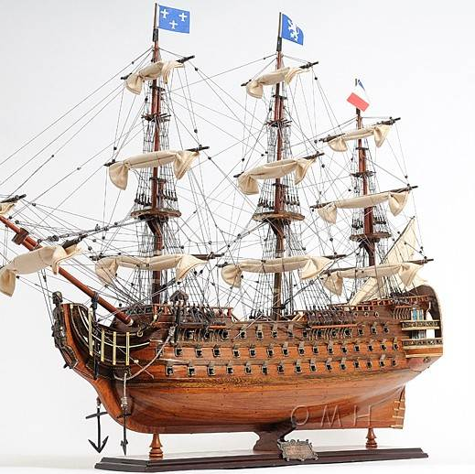
A Model or a Simulator?
Notes:
British Royal Museum
Greenwich, UK
Many of the ship models in our collection were produced to comply with the Navy Board's order that required all ship draughts for new vessels and repairs to be accompanied by a scale model (1716). The Board was made up of sea officers and oversaw the logistical administration of the Royal Navy. It is believed the Board used models to review the appearance of proposed ships, including the general design, shape and decoration, though to what degree is not clear. Ship models were also commissioned to attract support and investment.

Slide 4
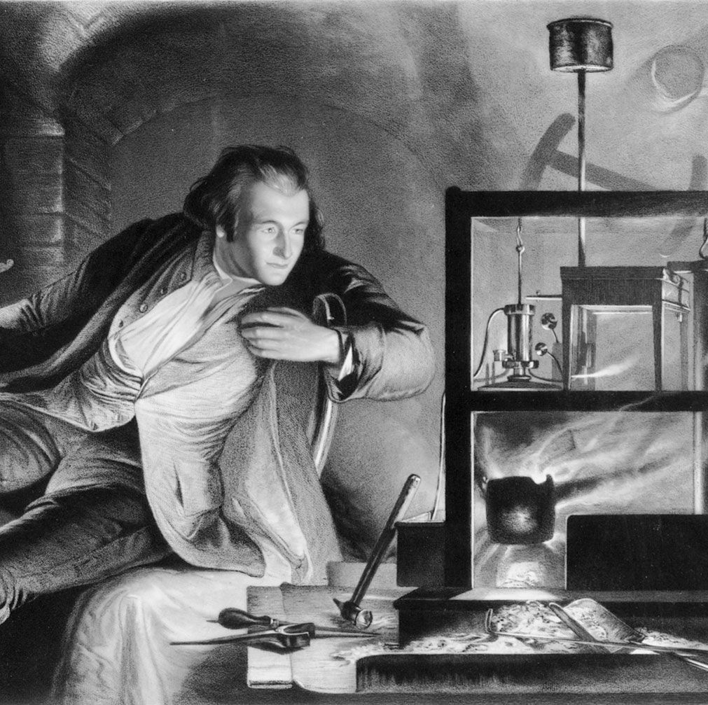
James Watt Working With a Simulator
Notes:
Repairing a Newcomen engine, added a condenser, efficiency, 1764

Slide 5
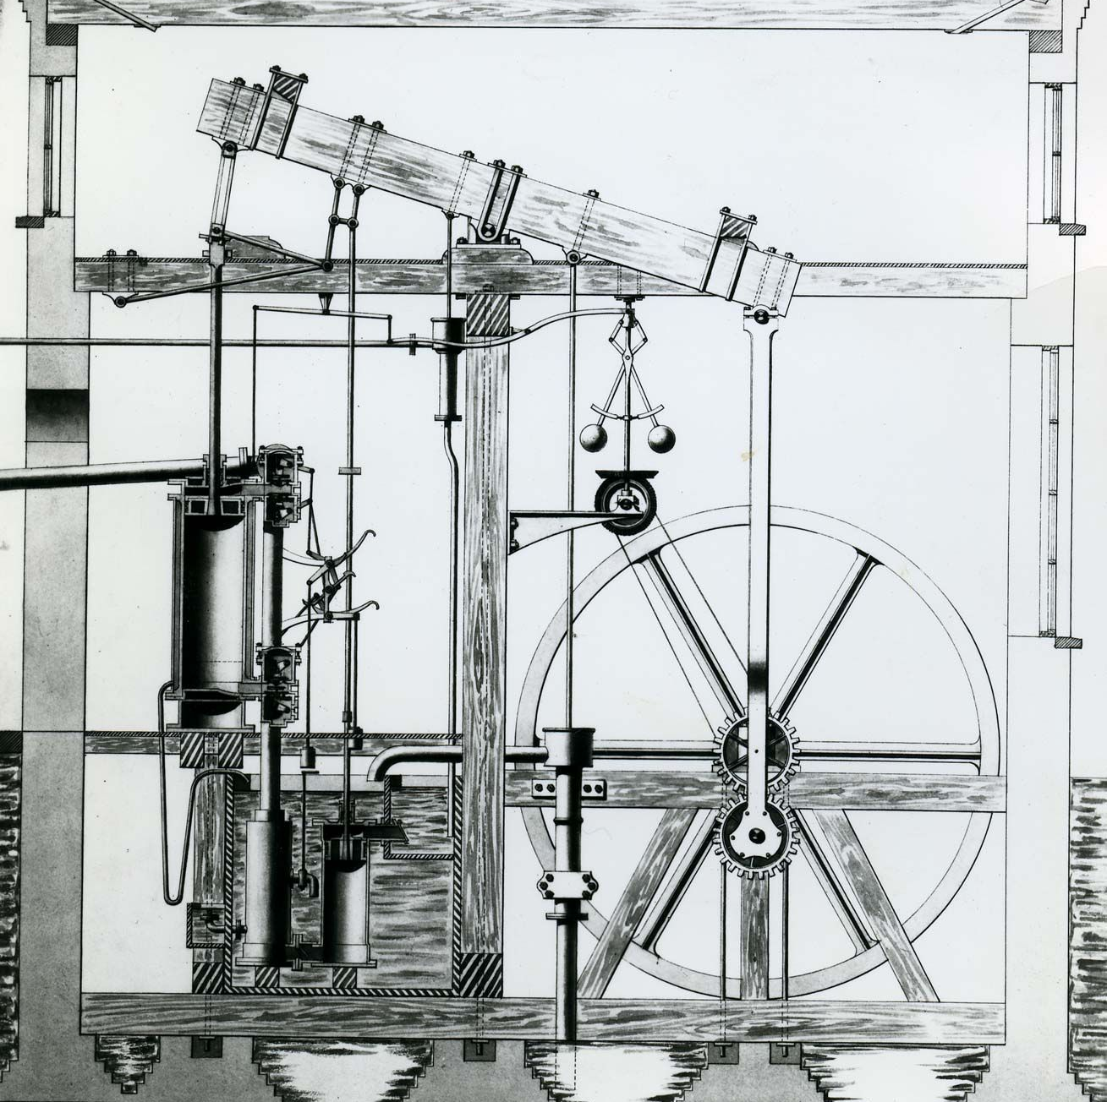
The Engine That Changed the World
Notes:
While repairing a model Newcomen steam engine in 1764, Watt was impressed by its waste of steam. In May 1765, after wrestling with the problem of improving it, he suddenly came upon a solution—the separate condenser, his first and greatest invention. Watt had realized that the loss of latent heat (the heat involved in changing the state of a substance—e.g., solid or liquid) was the worst defect of the Newcomen engine and that therefore condensation must be effected in a chamber distinct from the cylinder but connected to it. Shortly afterward he met British physician, chemist, and inventor John Roebuck, the founder of the Carron Works, who urged him to make an engine. He entered into partnership with him in 1768, after having made a small test engine with the help of loans from Joseph Black. The following year Watt took out the famous patent for “A New Invented Method of Lessening the Consumption of Steam and Fuel in Fire Engines.”

Slide 6
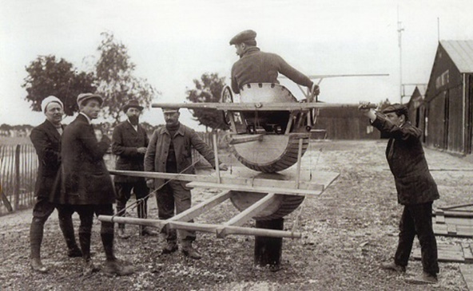
Antoinette Barrel - 1910
Notes:
42 years later
Early aviation was incredibly dangerous, with crashes being commonplace. The first aircraft lacked many of today’s safety protocols and often had controls that were not standardized. While the first powered flight was in 1903, flight simulators started to appear around 1910, and the French aviation manufacturer Antoinette developed one of the earliest working simulators for instructional purposes.
While Latham was able to set several records with Antoinette aircraft, they were difficult to fly. Rather than using a flight stick, the Antoinette planes used two wheels on opposite sides of the cockpit attached to a rudder bar and operated by hand, the left operating the ailerons, and the right for elevation. Many pilots found this control layout to be completely non-intuitive and had difficulty piloting the plane.
the company also created a simulator as an instruction tool for learning the complicated controls of the airplane. The result of this was the Antoinette Barrel, an aptly named simulator made out of a barrel cut in half, which was designed to minimize flight difficulty and to extensively familiarize the pilot with controls before taking off. The short wings attached to the barrel were placed around shoulder height so that instructors could manually move the wings or reposition the barrel, simulating turbulence. Emulating the controls of the aircraft, the wheels would manipulate the pitch and roll of the barrel, with the pilot’s goal to balance out the external forces exerted by the instructor, and aligning a bar with the horizon.

Slide 7
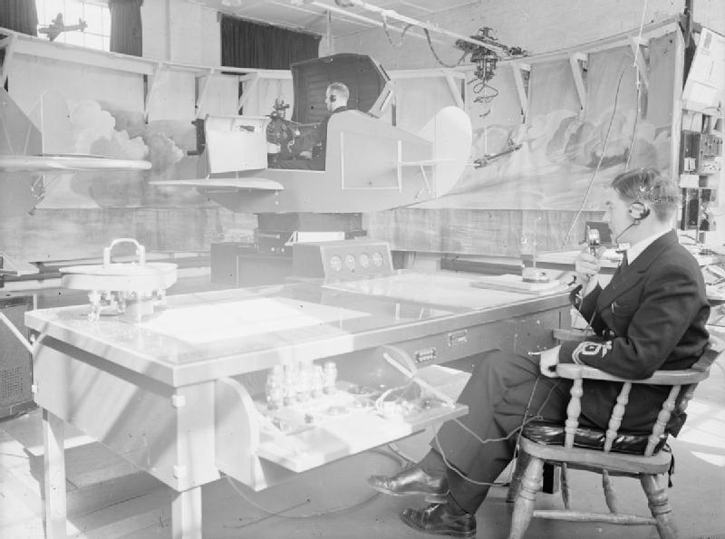
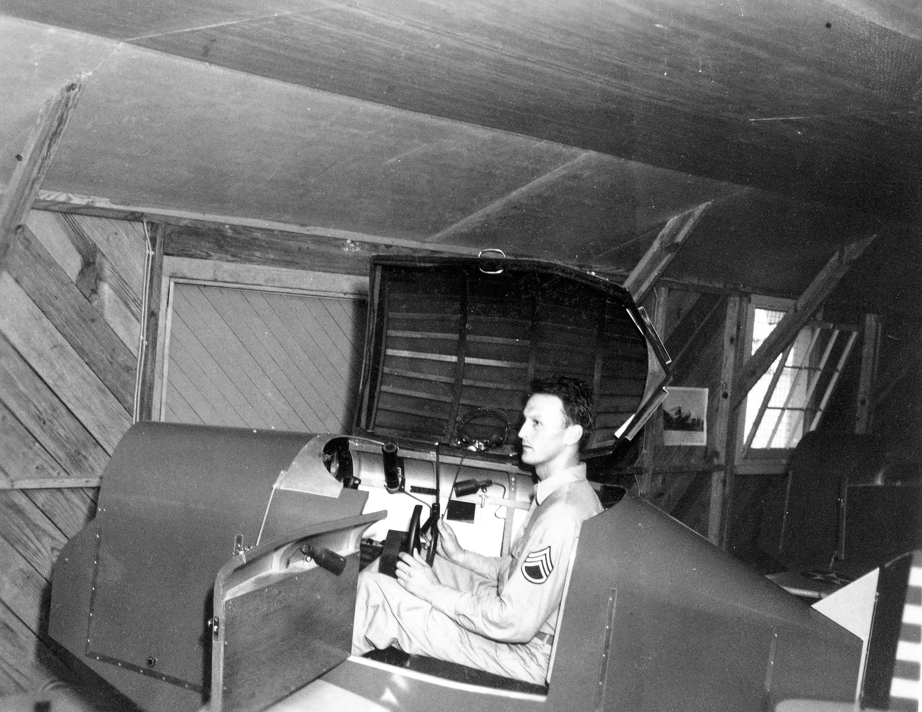
Link Simulator - 1934
Notes:
Edwin Link had developed a passion for flying in his boyhood years, but was not able to afford the high cost of flying lessons. So, upon leaving school in 1927, he started developing a simulator. The project took him 18 months. His first pilot trainer, which debuted in 1929, resembled an overgrown toy airplane from the outside, with short wooden wings and fuselage mounted on a universal joint. Organ bellows from the Link organ factory, the business his family owned and operated in Binghamton, New York, driven by an electric pump, made the trainer pitch and roll as the pilot worked the controls.^{[5]}
Link's first military sales came as a result of the Air Mail scandal, when the Army Air Corps took over carriage of U.S. Air Mail. Twelve pilots were killed in a 78-day period due to their unfamiliarity with Instrument Flying Conditions. The large scale loss of life prompted the Air Corps to look at a number of solutions, including Link's pilot trainer. The Air Corps was given a stark demonstration of the potential of instrument training when, in 1934, Link flew in to a meeting in conditions of fog that the Air Corps evaluation team regarded as unflyable.^{[5]} As a result, the Air Corps ordered the first six pilot trainers on 23 June 1934 for $3,500 each. In 1936, the more advanced Model C was introduced.^{[6][7]}
American Airlines became the first commercial airline to purchase a Link trainer in 1937.^{[8]} Prior to World War II, Link trainers were also sold to the U.S. Navy, Civil Aeronautics Administration, Germany, Japan, England, Russia, France, and Canada.^{[9]}

Slide 8
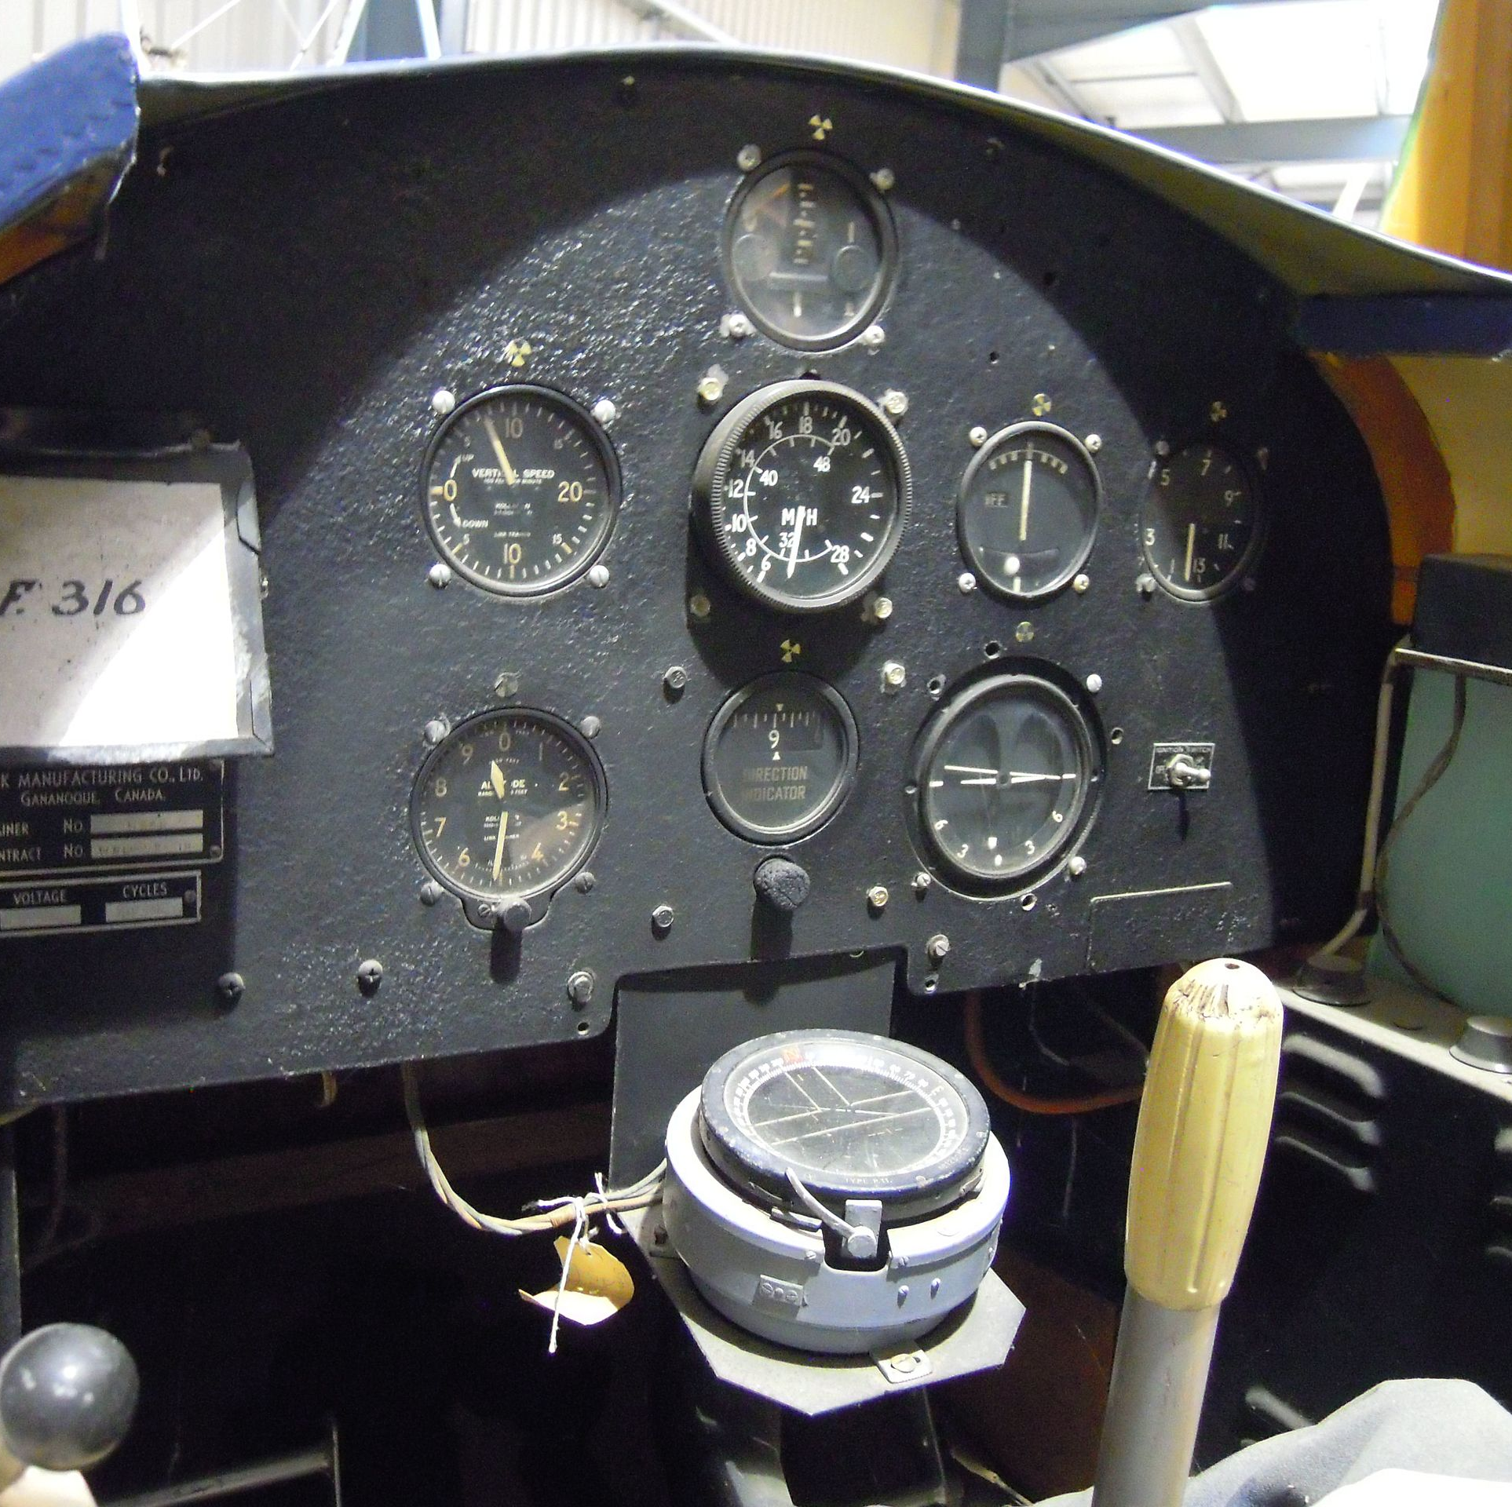
Could You Land this Airplane?
Notes:
How about in fog?

Slide 9
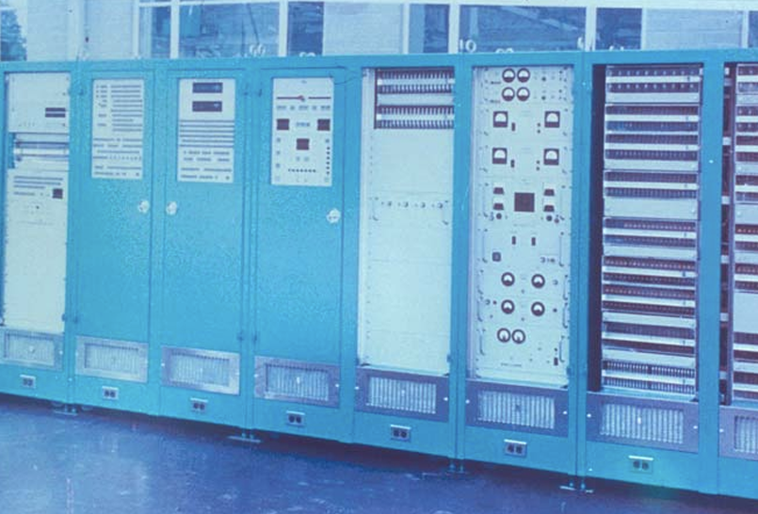
Real Time Flight Simulation – Digital Computers
Universal Digital Operational Flight Trainer - 1960
Notes:
Even with improved hardware and design, the reliability of the large analogue simulators of the day began to fall and despite continuous efforts by large maintenance teams, reliable utilisation of 10-12 hours a day appeared the maximum achieveable. It became obvious that the demands for increased fidelity and reliability could no longer be achieved with the analogue computer. The general purpose digital computers of the day could not be used for real time flight simulation due to their poor arithmetic and input /output capabilities and it was indeed fortunate that a second generation of digital computers was then being developed which appeared able to satisfy the speed and cost requirements of flight simulation. A research programme was initiated by the University of Pennsylvania in 1950 which resulted in a special purpose device being designed at the University which was named UDOFT (Universal Digital Operational Flight Trainer) (15) which was actually manufactured by the Sylvania Corporation in 1960.

Slide 10
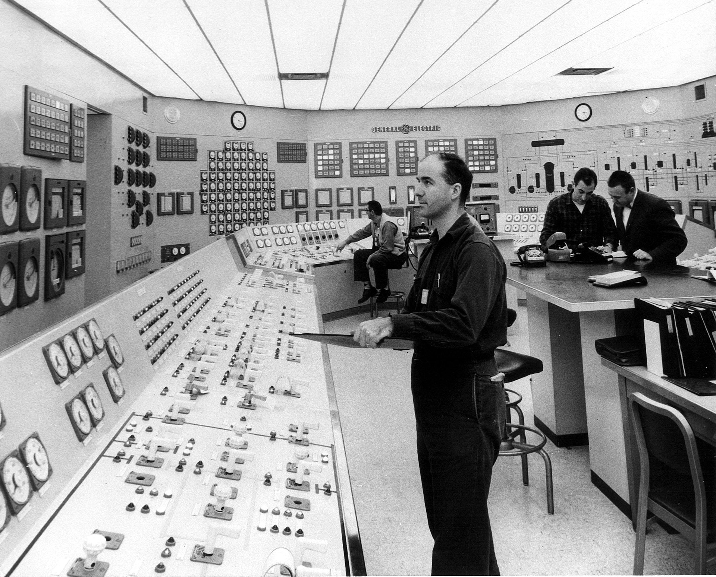
First Nuclear Plant Simulator – 1968, Dresden II
Notes:
Built by GE, 1968 BWR
1971 Simulator training could count as actual operating experience
Dresden II still in operatiion
Before, all training done on live plants
1st Commercial Nuclear Plant in operation Shippingport 1958

Slide 11
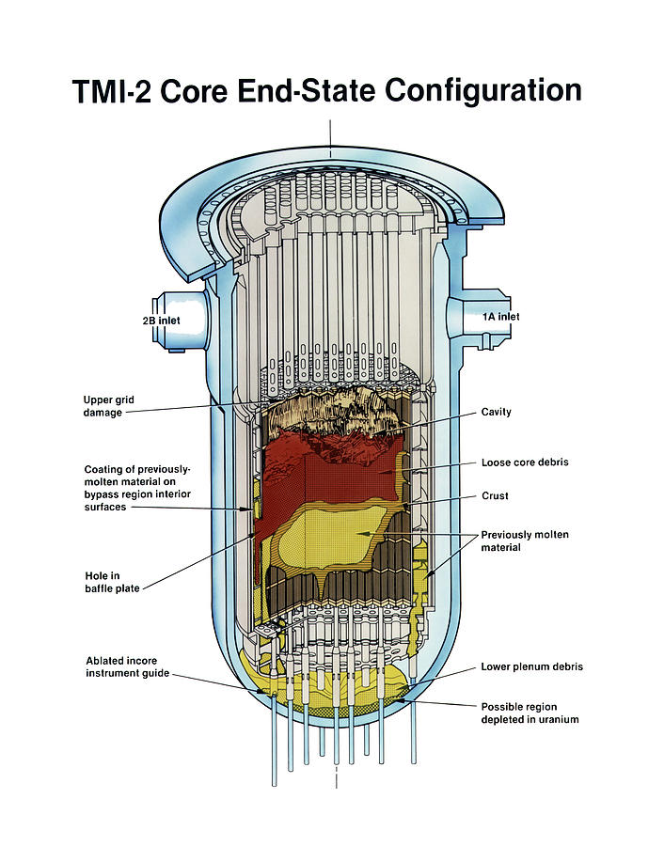
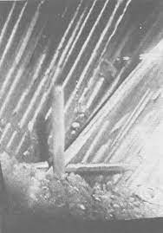
Simulators Become Mandatory for All Commercial Nuclear Plants - 1980
TMI Fuel Rod Damage
Notes:
TMI was the first malfunction globally in commercial nuclear power generation history and received widespread national and international media coverage. An investigation was commissioned by the federal government (informally known as the Kemeny Report [5]) that brought about major changes to training thereafter. For example, standardized operations staff training became a mandate, with a shift in protocol to firstly protect a plant’s cooling capacity, whatever alarms and triggers occur [4].
Importantly for the use of simulators, the U.S. Nuclear Regulatory Commission (NRC) issued the Post-TMI Action Plan (NUREG-0660), which included required improvements in the “use of and variety in simulator training” [6]. Onsite computerized training simulators became mandatory for each plant, with plants unable to maintain accreditation and trainees unable to obtain licenses without first passing simulator-based examination acceptable to the U.S. NRC. Simulator courses became a requirement and would become subject to regular audits of training procedures, lesson plans and suitably qualified instructors who previously were not subject to examination. Importantly, NUREG-0660 outlined that simulated abnormal and emergency scenarios must become a standard feature of operator training and that teamwork aspects of safe operations must be emphasized in simulator training.
TMI Accident 1973
1980

Slide 12
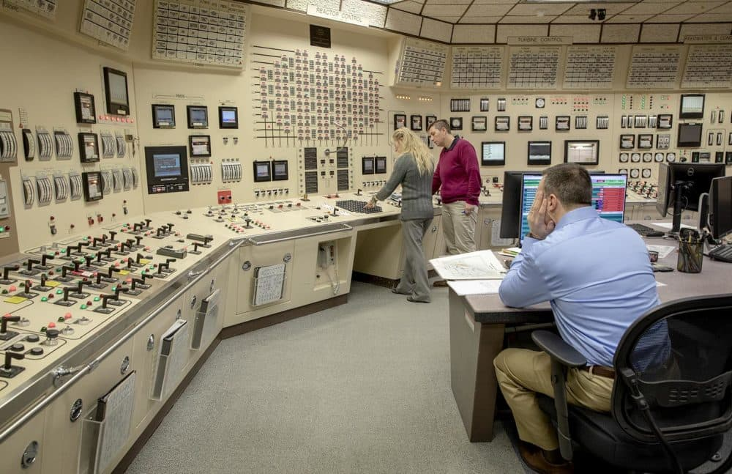
Simulator Identical to Plant Control Room - Today
Notes:
Pilgrim NPP
Down to tiles on celling
My story, B&W, CE

Slide 13
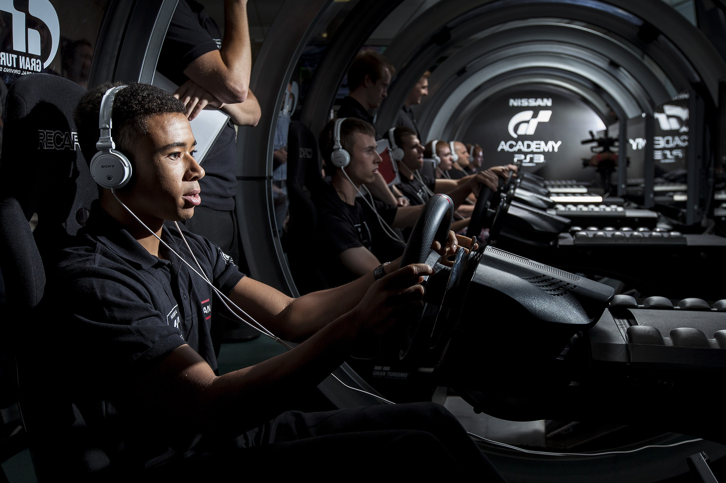
Gran Turismo - How Good is Your Simulator?
Notes:
Gran Turismo^{[a][b]} (GT) is a series of racing simulation video games developed by Polyphony Digital. Released on PlayStation systems, Gran Turismo games are intended to emulate the appearance and performance of a large selection of vehicles, most of which are licensed reproductions of real-world automobiles. Since the franchise's debut in 1997, over 90 million units have been sold worldwide, making it the best selling video game franchise under the PlayStation brand.^{[3][4][5]} An adapted film based on the series and Jann Mardenborough's career was released in August 2023 and directed by Neill Blomkamp.
The appeal of the Gran Turismo series is due significantly to its graphics, a large number of licensed vehicles, attention to vehicle detail, accurate driving physics emulation, and the ability to tune performance, hence the subtitle "The Real Driving Simulator", incorporated to the franchise's iconography since Gran Turismo 4. Handling of the vehicles is modeled on real-life driving impressions, tuning is based on principles of physics, and the sound of the vehicle's engine is based on recordings of the actual vehicles. The game has been a flagship for the PlayStation console's graphics capabilities, and is often used to demonstrate the system's potential.
Winners of the Gran Turismo Academy include Lucas Ordóñez, Jordan Tresson and Jann Mardenborough, who have all gone on to compete in professional real-life racing. Some of these winners, who would normally be seen as "non-professionals", have received praise relating to how they are as skilled as drivers with years of experience.

Slide 14
SIMULATOR FEATURE FRAMEWORK: REQUIREMENTS TO SUPPORT TRAINING, RESEARCH, AND EDUCATION
Gideon, O., & Ulrich, T. A. (2023, September). Simulator Feature Framework: Requirements to Support Training, Research, and Education. In Proceedings of the Human Factors and Ergonomics Society Annual Meeting (Vol. 67, No. 1, pp. 1109-1115). Sage CA: Los Angeles, CA: SAGE Publications.

Slide 15
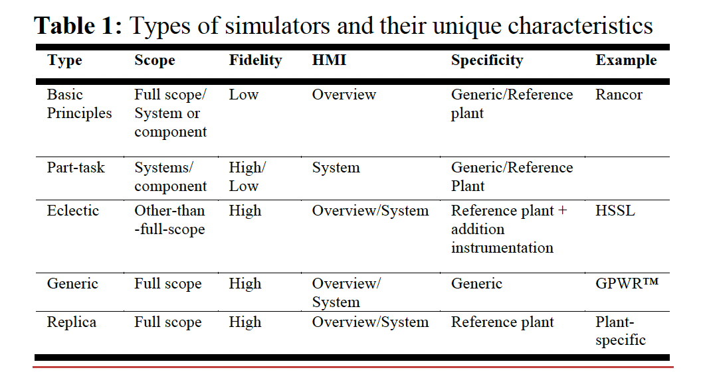
Types of Current Simulators

Slide 16
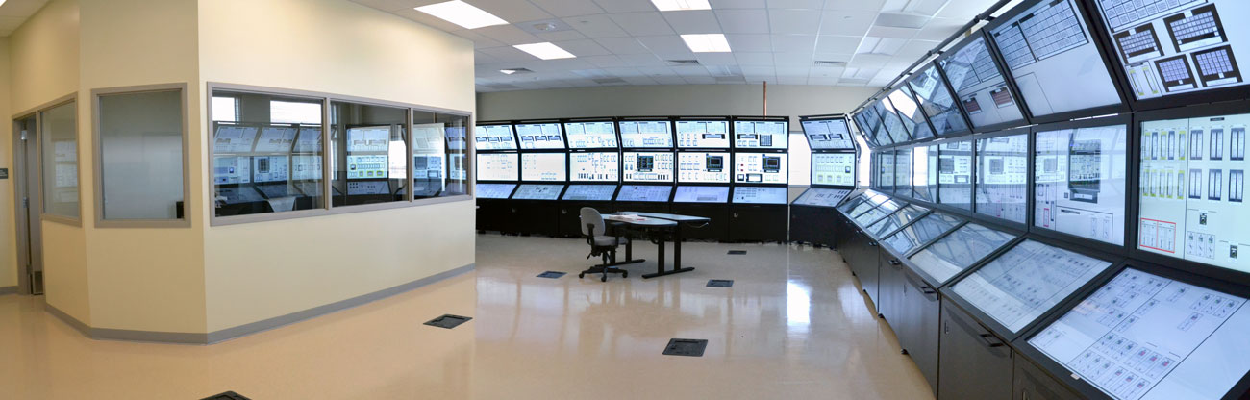
Human Systems Simulation Laboratory (HSSL) Idaho National Laboratory

Slide 17
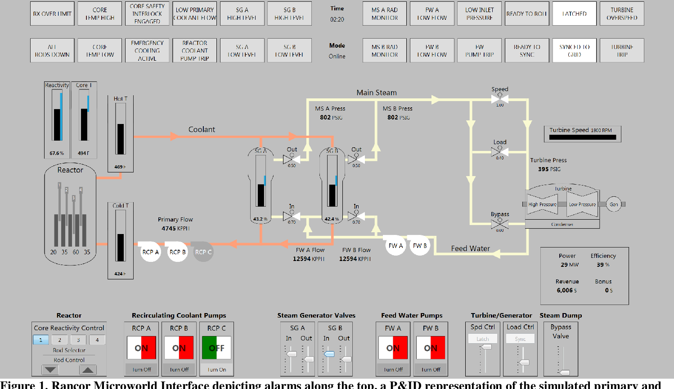
Rancor Microworld Simulator
Ulrich, T.A., Lew, R.T., Werner, S., & Boring, R.L. (2017). Rancor: A Gamified Microworld Nuclear Power Plant Simulation for Engineering Psychology Research and Process Control Applications. Proceedings of the Human Factors and Ergonomics Society Annual Meeting, 61, 398 - 402.

Slide 18
Simulator Features & Capabilities that Support User Requirements
Reconfigurable Simulator Software
Open-source Software Development Model
Integrated Human Performance Measurement System
Remote Access
Cybersecurity Support
Representation of Advanced Reactor Concepts
Human Reliability Analysis
Scenario Configurability across all Plant Operational States
Notes:
Research simulator verses replica simulator

Slide 19
Reconfigurable Simulator Software
Digital control & display
Accommodate different plants and vendor systems
External validity
Client-server software architecture
Open-source disk cloning and imaging software
Virtualization of server
Notes:
External validity and ecological validity are of paramount importance to the generalizability of control room simulator studies. Given that
most training simulators are exact replicas of an underlying specific plant and control room design, the high degree of
variability in crew organization and dynamics is a major challenge to the generalizability of control room simulator research findings. Therefore, a reconfigurable simulator
software that offers the ability to switch between control room panels of different plant vendors and models is an important requirement for simulator research and education.

Slide 20
Open-source Software Development Model
Open-source code user license
High reliability requirements of systems in an NPP requires access to both source code and development history of underlying software for cybersecurity research and reliability studies
High adoption of OS provides large sample size for performance validation for computer-based systems, some still in development stage
Digital I&C efforts could benefit from reuse of development history of OSS in control room modernization and advanced reactor development efforts
Notes:
There are two
opposing paradigms in software development—proprietary
software and open-source software. An open-source software
(OSS) is one with its source code readily available for use,
distribution, and modification by the public (Joo, Suh, & Park,
2016). Several motivations driving the upward trend in OSS
adoption include quality, maintainability, and reliability or the dependability of the software

Slide 21
Integrated Human Performance Measurement System
Observation gallery
Trainers, students, researchers
Multiple measurement system – eye tracking, physiological measurement, video, and audio data capture
Real-time synchronization of multiple data sources

Slide 22
Remote Access
Open operation to distance learning and certifications
Large capital cost for installation
Remote troubleshooting and maintenance
Simulator observation hours can be met on-line for plant operators
Security achieved through secure network
Virtual Private Network (VPN)

Slide 23
Cybersecurity Support
Critical feature for digital systems, advanced reactors, future remote operation
Simulation of sensors and actuators to model network traffic communication
Ability to uniquely tag relevant signals to enable replacement of simulated block with a physical counterpart to allow hardware-in-the loop (HIL) studies
Cyber-attacks scenario configuration for simulating adversarial hijack, for data collection, and network sniffing

Slide 24
Representation of Advanced Reactor Concepts
Passive safety concepts
Walk away safe
No active safety equipment required
No offsite electrical power required for safe shutdown
Emergency Planning Zone at plant site boundary (security fence)
Versatility of thermal energy concepts
Hydrogen generation
Hybrid operation for grid balancing
Micro grid
Digital instrumentation and control concepts
Operating multiple units from one control room – NewScale
Remote operation

Slide 25
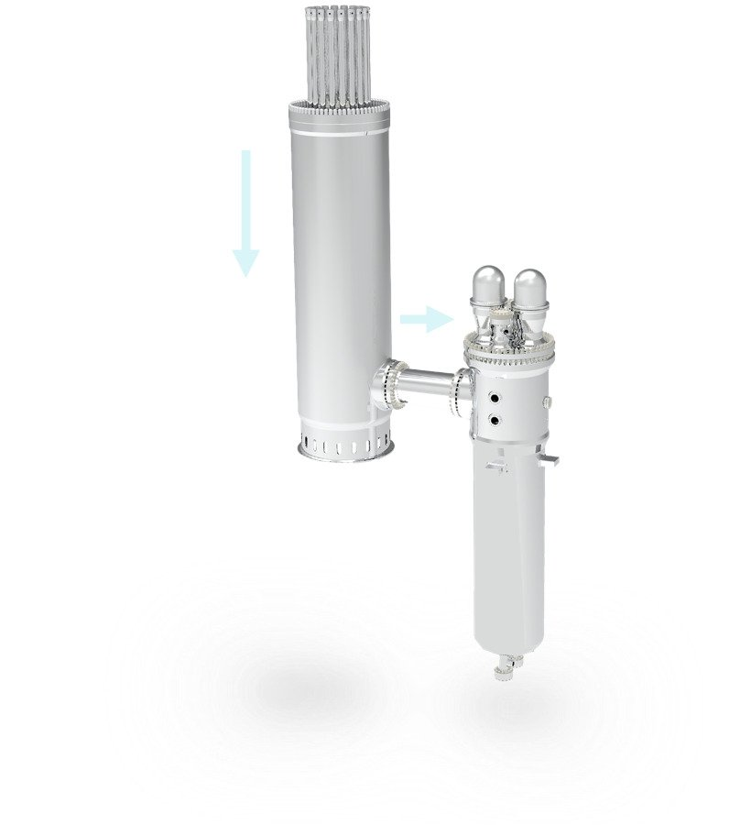
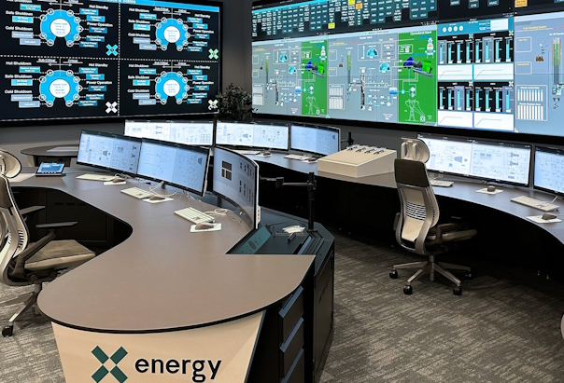

X-Energy Advanced Reactor Simulator
Notes:
The Plant Support Center (PSC) will train up to 52 operators at one time with a training programme that will use virtual and simulated environments to provide trainees with hands-on experience before entering the field. It will support training for the initial deployment of the Xe-100 at Dow’s Seadrift manufacturing facility in Texas.
The control room simulator is the PSC's centrepiece and replicates a real-world plant control room, X-energy said. The Xe-100's control room boasts automated digital systems and is designed to enhance operator experience and increase cost efficiencies
80Mw Electric, High Temp Gas Cooled, Meltdown Proof

Slide 26
Human Reliability Analysis
(HRA) is a probabilistic means of determining and quantifying chances of human failure events (HFEs) in complex operating environments. In NPP operations, HRA enables examining the likelihood of operator error across all plant operational states.
Ability to model:
Pre-initiator events – equipment left in wrong state after maintenance
Post-initiator events – poor operator response to an event
Performance shaping factors – tired, hot, fatigue

Slide 27
Scenario Configurability across all Plant Operational States
Ability to model scenarios of:
Normal operational state
Outage operational state (startup &shutdown)
Emergency operational state (LOCA & SGTR)
Essential for operational training, operator-in-the-loop studies to understand operator performance under different scenarios

Slide 28
Conclusions
Use of control room simulator for research beyond traditional operator training.
Modern simulator designs must possess more robust capabilities to serve the broad needs of multiple user groups
Simulator Feature Framework provides a common index for evaluating important simulator features
Support current plant modernization initiatives
Advanced reactor deployment
Next Steps
Evaluate the suitability of framework in characterizing and differentiating simulators
Training, research and education use cases should be evaluated

Slide 29

Questions?

